Slide 1
Comparison of K-Anonymity, L-Diversity and Differential Privacy Techniques
By Aniket Tiwari (MDS202308) & Kironmoy Roy (MDS202332)
Chennai Mathematical Institute

Slide 2

Comparison of K-Anonymity, L-Diversity, and Differential Privacy
Understanding privacy-preserving techniques is critical in a data-driven world. This presentation explores three fundamental methods: K-Anonymity, L-Diversity, and Differential Privacy. Each method offers unique ways to protect sensitive information while maintaining data utility. Our goal is to provide clarity on these techniques, their applications, and implications in modern privacy contexts.

Slide 3

Introduction to Privacy-Preserving Techniques
Why Data Privacy Matters
Key Privacy Concepts
Modern applications collect vast amounts of data; protecting user privacy is essential to prevent misuse and build trust.
Understanding quasi-identifiers—attributes that can indirectly identify individuals—and sensitive attributes is foundational.
Techniques Covered
We introduce K-Anonymity, which obscures identities, L-Diversity, which protects sensitive attributes, and Differential Privacy, which adds noise for strong privacy.

Slide 4

Project Objectives
1
Understand Core Techniques
Dive deep into K-Anonymity, L-Diversity, and Differential Privacy concepts and mechanisms.
2
Practical Implementation
Apply each method to a dataset to see their effects and limitations in action.
3
Compare and Contrast
Analyze strengths, weaknesses, and trade-offs, focusing on privacy protection and data utility balance.
4
Informed Evaluation
Assess which technique suits different contexts and privacy requirements effectively.

Slide 5

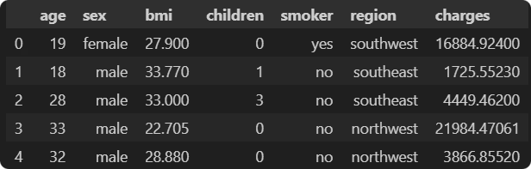
Dataset Overview: Adult Income Dataset (UCI)
Dataset Source
Relevance to Privacy Research
This dataset contains demographic and personal data related to individuals, along with the medical insurance charges billed to them. It’s typically used to model or predict medical insurance costs.
This dataset’s typical quasi-identifiers and sensitive attributes provide a realistic testing ground for privacy techniques.
Its rich attribute set allows detailed privacy risk assessments and utility analysis.
Size: 1,338 entries
Attributes: age, sex, bmi, children smoker etc.

Slide 6
Exploratory Data Analysis (EDA)
Key Attribute Distributions
Quasi-Identifier Identification
Checked data types, missing values, distributions
Detected attributes likely to reveal identities, such as age, sex, bmi and region serving as quasi-identifiers.
Found no missing values
Categorical: sex, smoker, region
Sensitive Attributes are charges and smoker
Numerical: age, bmi, children, charges
Distributions used to inform generalization/noise strategies

Slide 7

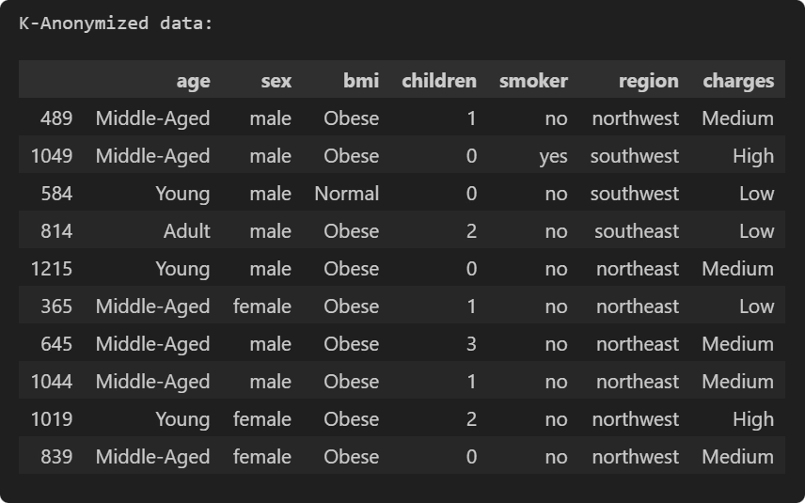
K-Anonymity: Achieving k-Indistinguishability
Core Concept
Ensures that each individual is indistinguishable among at least k individuals by grouping similar records.
Techniques
Uses generalization (e.g., replacing exact ages with ranges) and suppression (removing details) to mask identities.
Pros & Cons
Simple and effective for identity protection but vulnerable to attribute disclosure and background knowledge attacks.

Slide 8
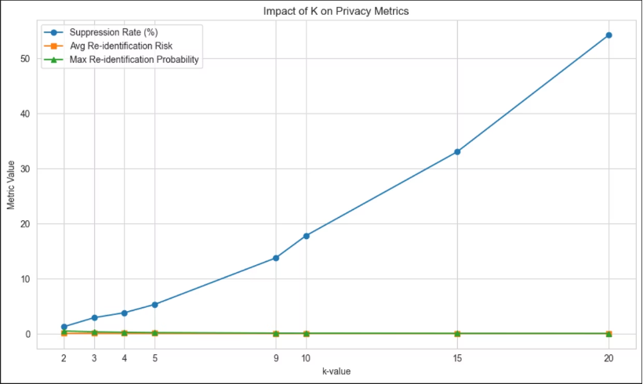
What value should we choose for K?
We choose k = 10 because it provides a good balance between privacy and data utility
Suppression rate (~18%) is still manageable (lower than for higher k-values).
Avg re-identification risk and max re-identification probability are already minimized and remain stable across higher k-values
So, k = 10 ensures strong privacy protection without excessive data loss.

Slide 9

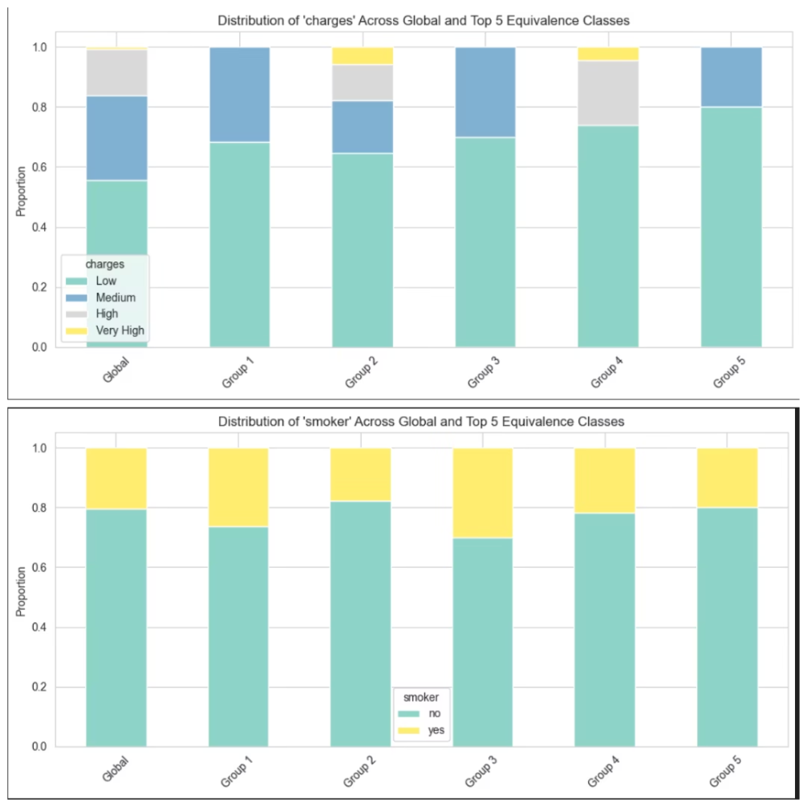
L-Diversity: Addressing Attribute Disclosure
Definition
Each group has at least l well-represented sensitive attribute values, preventing sensitive value disclosure.
Techniques
Entropy l-diversity ensures randomness; distinct l-diversity ensures variety within groups.
Limitations
May be challenging to implement with strict l, and might not protect against similarity-based inference.

Slide 10
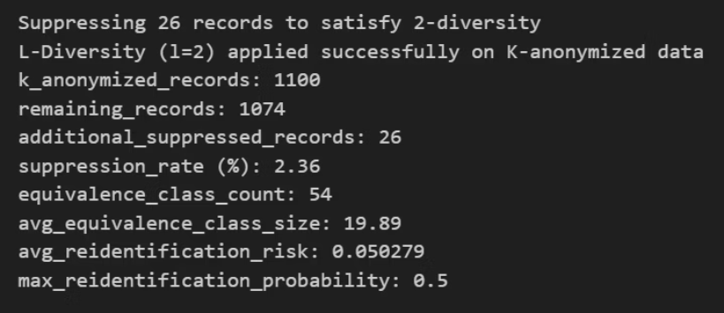
What value should we choose for L?
Choosing l = 2 ensures 2-diversity, each equivalence class has at least two distinct values for the sensitive attribute.
This helps prevent attribute disclosure—even if someone knows a person is in Group 1, they can't confidently infer a single sensitive value (like being a smoker or having very high charges).
Higher L values may over-generalize data or reduce utility, so L=2 is a practical balance between privacy and data utility.

Slide 11

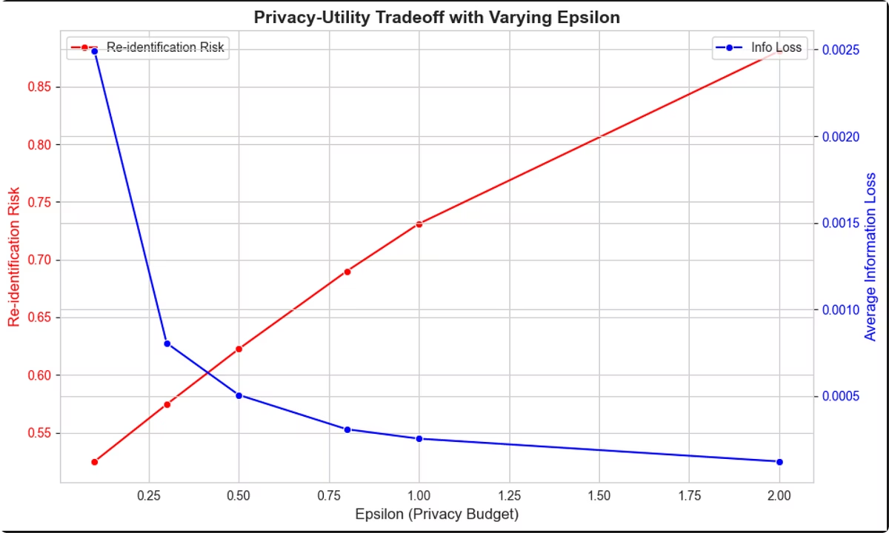
Differential Privacy: Adding Noise for Privacy
Concept
1
Ensures an analysis output is virtually unaffected by the presence or absence of any single individual.
Mechanism
2
Introduces calibrated random noise to query results controlled by privacy budget parameter ε (epsilon).
Strengths & Weaknesses
3
Strong privacy guarantees robust to many attacks but may reduce data accuracy and require careful tuning.

Slide 12
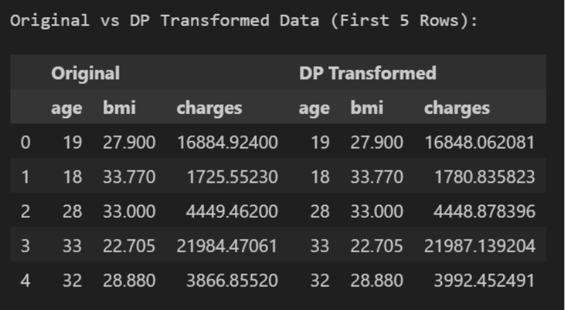
Summary of Original and DP Transformed
Minimal Distortion: The differentially private (DP) transformed values are very close to the original values, indicating that the added noise is minimal and preserves data utility.
Preserved Trends: The rank order and general trends of the data (e.g., age and charges increasing together) remain intact after transformation.
Privacy with Utility: The transformation provides privacy protection (via differential privacy) while retaining enough accuracy for analysis.
Attribute Consistency: Non-sensitive attributes like age and bmi remain unchanged, implying selective noise addition only to sensitive values like charges.

Slide 13

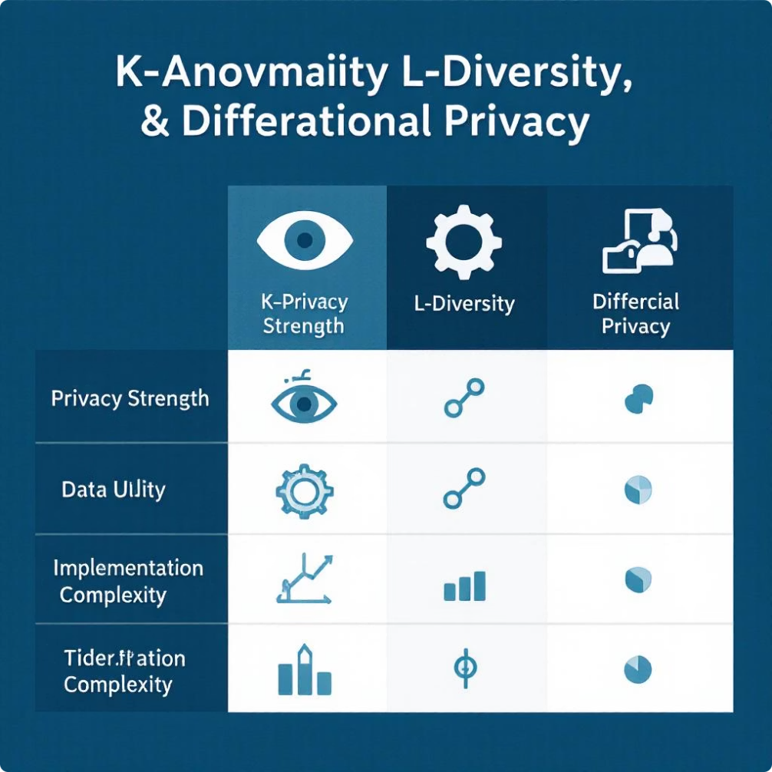
Comparative Analysis
Technique
Privacy Level
Data Utility
Implementation
K-Anonymity
Weak
High
Low
L-Diversity
Moderate
Moderate
Moderate
Differential Privacy
Strong
Low
High
This comparison highlights the trade-offs between privacy protection, data utility, and implementation effort, enabling you to select the technique that best aligns with your privacy needs and data objectives.

Slide 14





Challenges Faced and Conclusion
Balancing Privacy and Utility
Striking the right balance between strong privacy protection and maintaining data usefulness is a persistent challenge.
Parameter Selection
Choosing appropriate k, l, and ε values requires deep understanding and often domain-specific calibration.
Emerging Threats
Sophisticated attacks demand continuous refinement of privacy methods to stay effective and relevant.
Conclusion
Selecting the right privacy technique hinges on the specific data context and the desired privacy-utility trade-off, emphasizing the importance of tailored solutions.

Slide 15
Thank You

